Slide 1
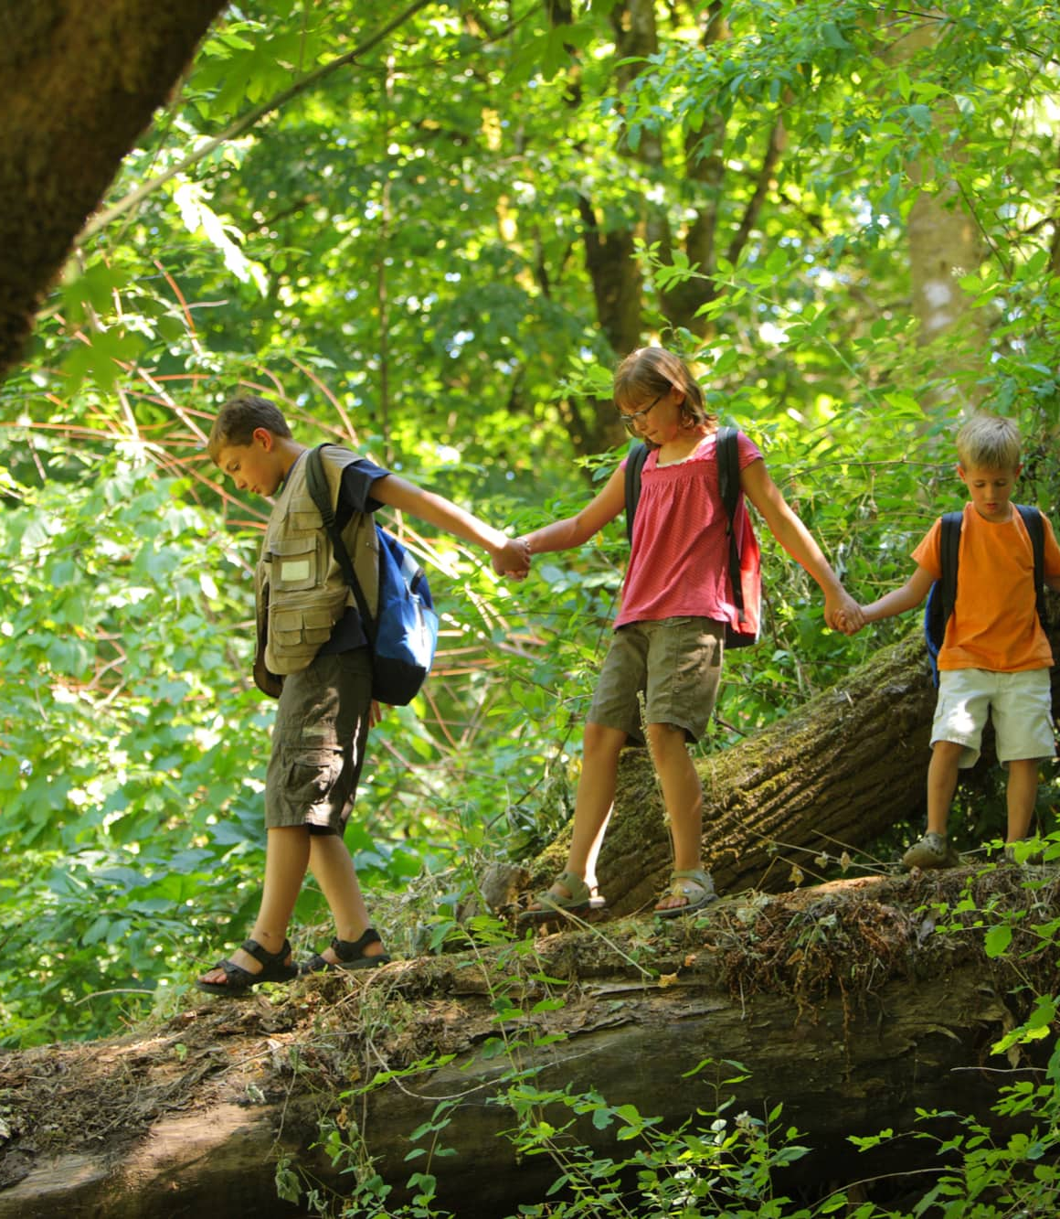
Bipedal Bodies, Learning Minds: Why Children Learn Best in Nature

Slide 2
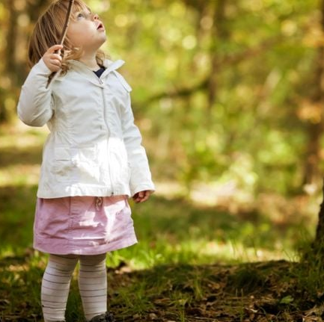
What Is Bipedalism?
Bipedalism = walking upright on two legs
One of the most significant human evolutionary adaptations
Frees the hands for carrying, building, manipulating objects, and tool use
Requires advanced balance, coordination, and postural control
Changes visual perspective and spatial awareness
Research link: Evolutionary biology shows bipedalism supported tool use, exploration, and brain expansion (Lieberman, 2011).

Slide 3
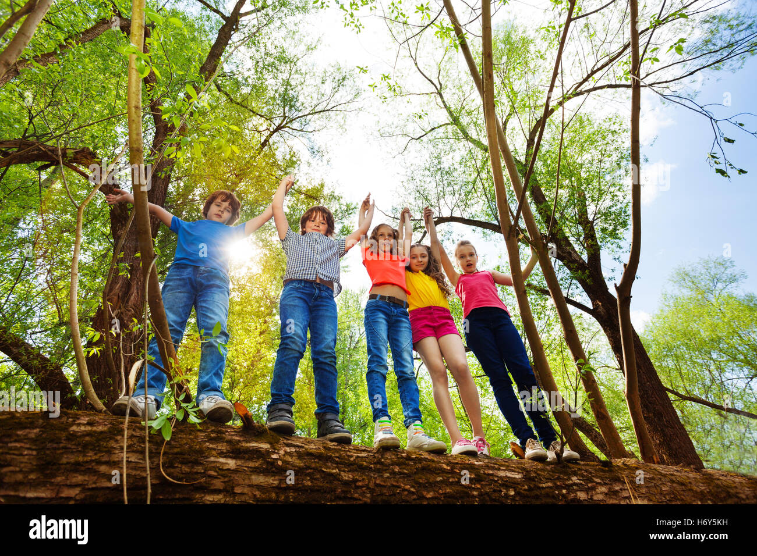
Movement and Brain Development
Children learn best outdoors because humans evolved as bipedal beings in natural environments.
Learning is rooted in biology, development, and evolution
Human bodies and brains evolved together through movement
Outdoor learning is developmentally appropriate, not enrichment
Forest School aligns with how children are physically and neurologically designed to learn
Research link: Evolutionary and developmental theory highlights the role of movement and environment in cognitive development (Gibson, 1979; Diamond, 2015).

Slide 4
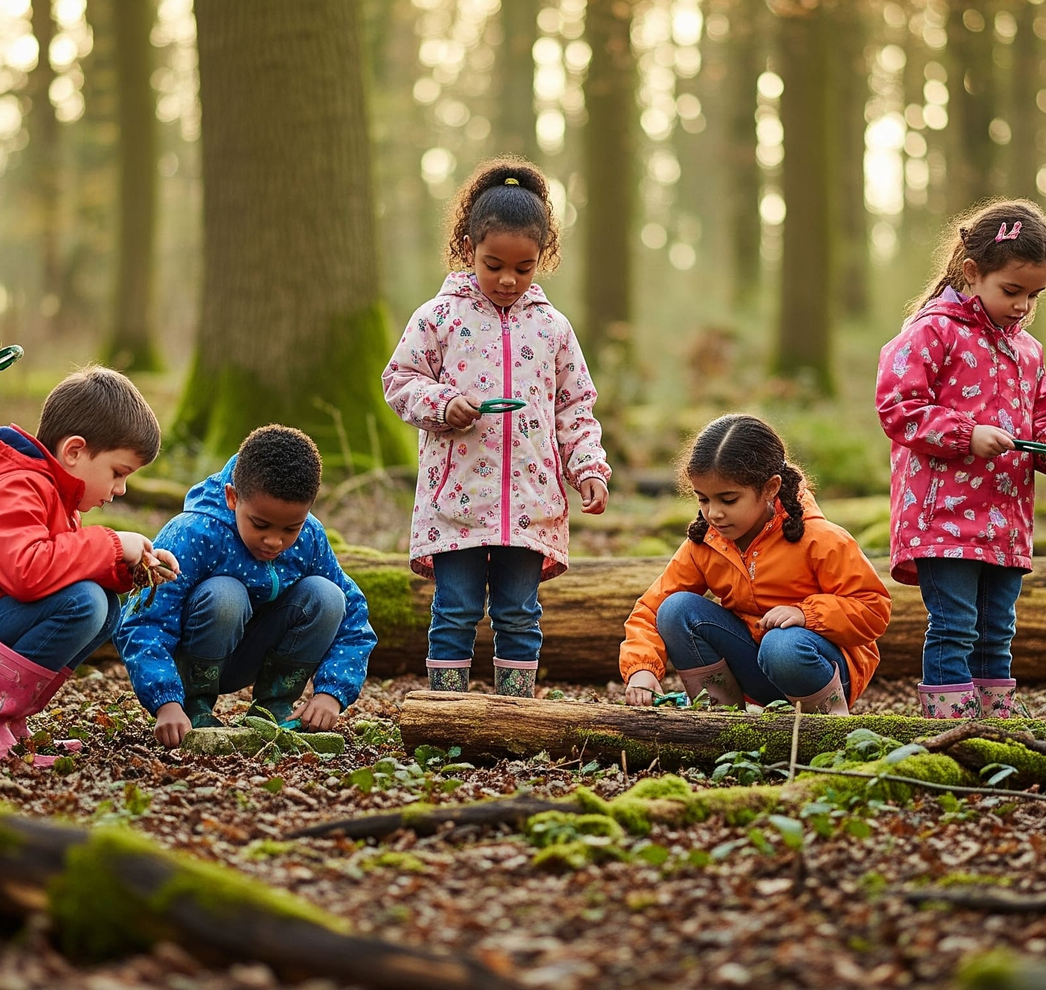
Evolutionary Context
Humans evolved:
Outdoors, not in enclosed indoor environments
In complex, unpredictable natural landscapes
Through movement, exploration, cooperation, and problem-solving
Children’s development still follows this evolutionary blueprint.
Research link: Ecological psychology emphasises learning through interaction with real environments (Gibson, 1979).

Slide 5
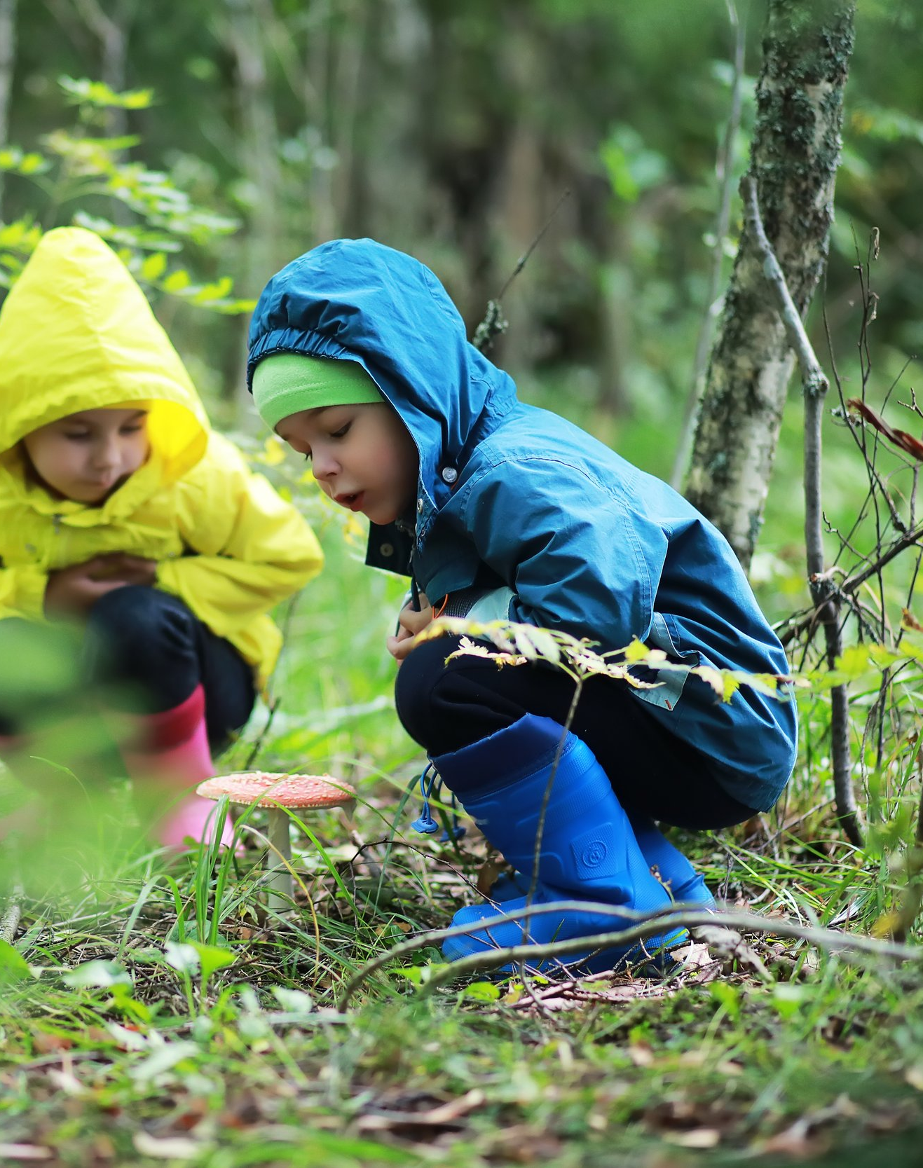
Movement and Brain Development
Movement is not a break from learning — it is a foundation for learning.
Walking, climbing, and balancing stimulate neural connections
Vestibular input supports attention and emotional regulation
Proprioceptive input supports body awareness and self-control
Research link: Physical activity is linked to improved executive function and academic readiness (Diamond, 2015; Ratey, 2008).

Slide 6
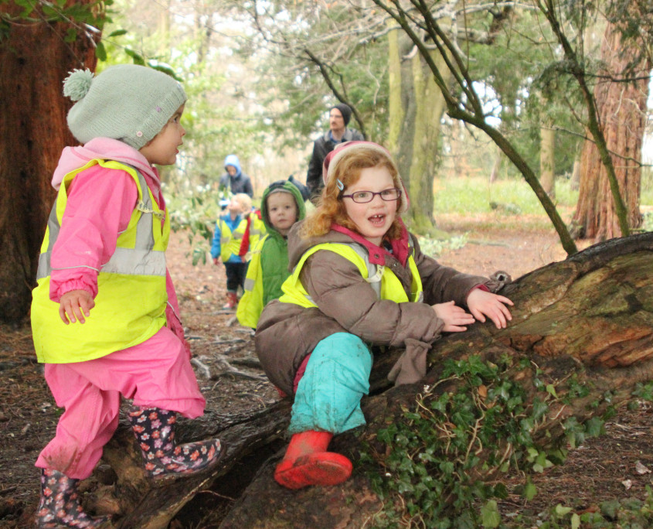
Embodied Learning
Humans learn through the body as well as the mind.
Cognitive development is linked to physical experience
Thinking develops through doing and exploration
Hands, posture, and movement support understanding
Research link: Embodied cognition research shows movement enhances conceptual learning (Wilson, 2002)

Slide 7
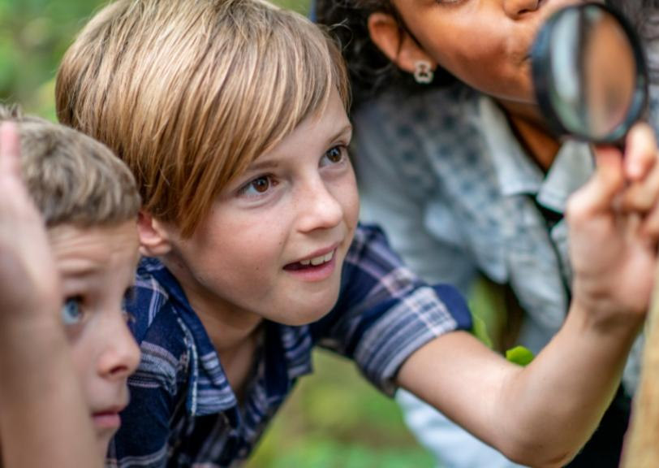
Benefits of Learning in Nature
Natural environments provide learning conditions that cannot be replicated indoors:
Uneven terrain supports balance, coordination, strength, and postural control
Natural materials and open-ended spaces promote critical thinking and problem-solving
Children must assess risk, plan actions, adapt strategies, and experience the outcomes of their decisions in a safe and guided way
Rich sensory input (sounds, textures, smells, visual depth) supports brain development and wellbeing
Hormones and wellbeing in nature:
Time spent in natural environments is associated with reduced cortisol (stress hormone)
Exposure to trees, greenery, and natural light supports the release of serotonin and dopamine, linked to mood, motivation, and emotional regulation
Hearing birdsong and natural sounds has been shown to reduce stress and improve attention and mental wellbeing
Research link: Attention Restoration Theory shows natural environments support focus and self-regulation (Kaplan & Kaplan, 1989). Studies also link nature exposure to reduced stress and improved mood and cognitive functioning (Ulrich, 1984; Bratman et al., 2019).

Slide 8
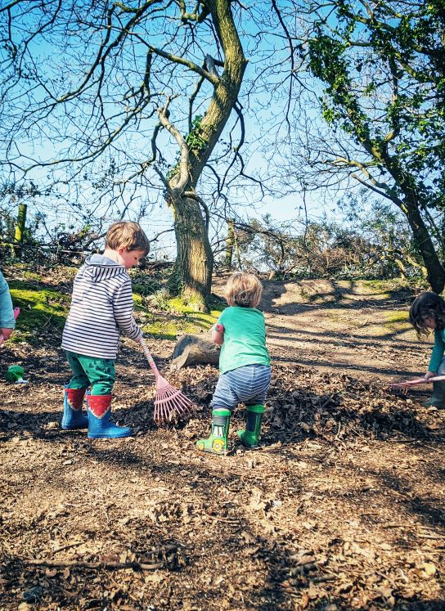
The Bipedal Child in Forest School
Forest School supports children as upright, mobile learners by allowing them to:
Move freely and purposefully across uneven terrain
Adjust posture and balance in response to natural ground conditions
Use hands while standing, walking, climbing, or balancing
Navigate space independently and assess risk
Learn through exploration and real-world problem-solving
Why uneven terrain matters: Uneven ground challenges balance, coordination, core strength, and spatial awareness, all of which are fundamental to bipedal movement and brain development.
Research link: Forest School evaluations show gains in confidence, physical competence, and self-regulation when children regularly move across natural, uneven environments (Forest Research & NEF, 2016).

Slide 9
Impact on Learning and Wellbeing Forest School supports children’s learning and development in multiple ways:
Encourages a growth mindset by allowing children to challenge themselves and learn from experiences
Fosters a sense of community and cooperation, where children support each other
Provides opportunities to gain cultural capital through exploring the natural world, using tools, learning about plants and animals, and engaging in outdoor problem-solving
Aligns closely with the Early Learning Goals, supporting physical, cognitive, social, and emotional development
Contributes to overall development, laying the foundation for a lifelong learning journey
Teaches practical life skills, promoting autonomy, confidence, and independence
Improves concentration, emotional regulation, resilience, communication, and collaboration
Research link: Longitudinal and review studies report positive developmental outcomes from Forest School participation, including social, physical, cognitive, and emotional growth (Forest Research, 2016; Educational Psychology Review, 2023).

Slide 10
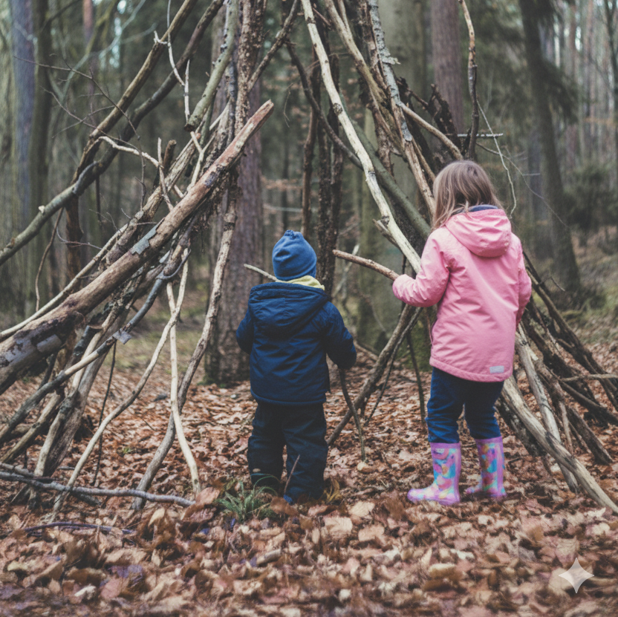
Implications for Teaching Practice
For effective, developmentally appropriate practice, educators should:
View movement as essential, not disruptive
Provide regular, meaningful outdoor learning opportunities, optimally in natural environments
Offer opportunities for children who are emotionally or behaviourally unregulated to take short walks or reflective time outdoors, including talking through their thoughts, which can support self-regulation and reduce reactive emotional responses. : A child who is feeling overwhelmed during Forest School may be invited to take a short walk along a woodland path, observing nature and talking quietly through their thoughts, either aloud or to themselves, before rejoining group activities. This approach helps them regulate emotions and return ready to engage in learning.
Trust children to manage appropriate risk
Plan learning experiences that engage the whole body and support cognitive, social, and emotional development
Research link: Outdoor learning aligns with effective early childhood pedagogy and EYFS principles and supports self-regulation and emotional control through movement and reflective time in nature (DfE; Waite, 2017; Coe et al., 2019).

Slide 11
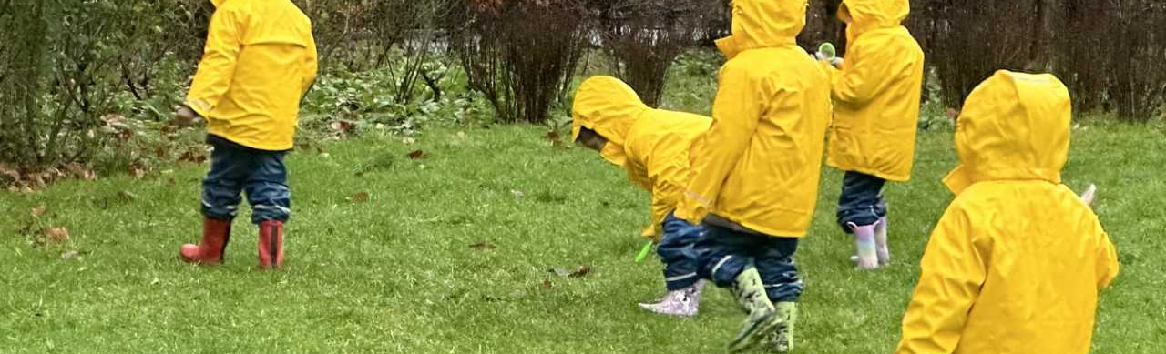
Reflection Questions
How does our current practice support — or limit — children’s need to move, explore, and learn as bipedal beings?
EYFS already provides opportunities for movement; how can we make physical activity more of a priority?
How can we encourage children to be more active at home and extend learning beyond school?
How can we ensure learning is child-led and initiated by the children themselves?
How can we engage children who are less active in the cohort and support them to participate?
What barriers exist beyond time and staffing, such as space, resources, or training, and do staff need further support or development?
Are there ways to integrate movement and exploration seamlessly into daily routines while maintaining curriculum objectives?

Slide 12
A summary of some key research underpinning Forest School and outdoor learning
Forest Research & New Economics Foundation (2016): Longitudinal UK evaluation shows Forest School improves confidence, communication, physical skills, motivation, and engagement, particularly for children who struggle in traditional classroom settings.
Natural Connections Demonstration Project (2016): Large-scale UK project found outdoor learning increases engagement, behaviour, enjoyment, and quality of teaching practice.
Kaplan & Kaplan (1989) – Attention Restoration Theory: Natural environments restore attention and reduce cognitive fatigue, supporting focus and self-regulation.
Diamond (2015): Executive function (self-control, working memory, flexible thinking) is strongly supported by movement and active learning.
Wilson (2002): Embodied cognition research shows children learn more deeply when learning involves movement and physical experience.
Ulrich (1984); Bratman et al. (2019): Nature exposure reduces stress, improves mood, and supports emotional regulation and mental wellbeing.
Waite et al. (2016; 2017): Forest School aligns with EYFS pedagogy, supporting child-led, developmentally appropriate, holistic learning.

